Slide 1






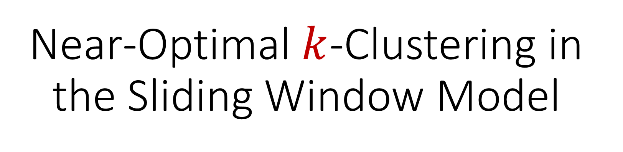
Near-Optimal $k$-Clustering in the Sliding Window Model
David P. Woodruff
Peilin Zhong
Samson Zhou

Slide 2
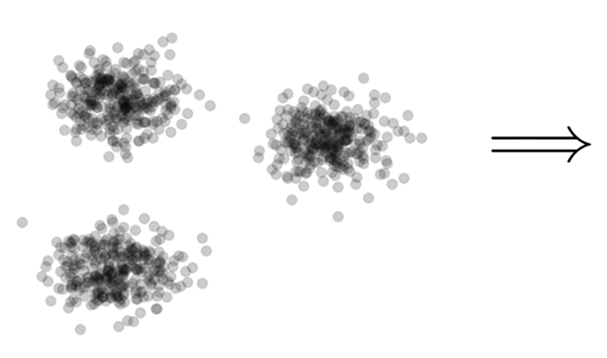

Clustering
Goal: Given input dataset $X$, partition $X$ so that “similar” points are in the same cluster and “different” points are in different clusters

Slide 3
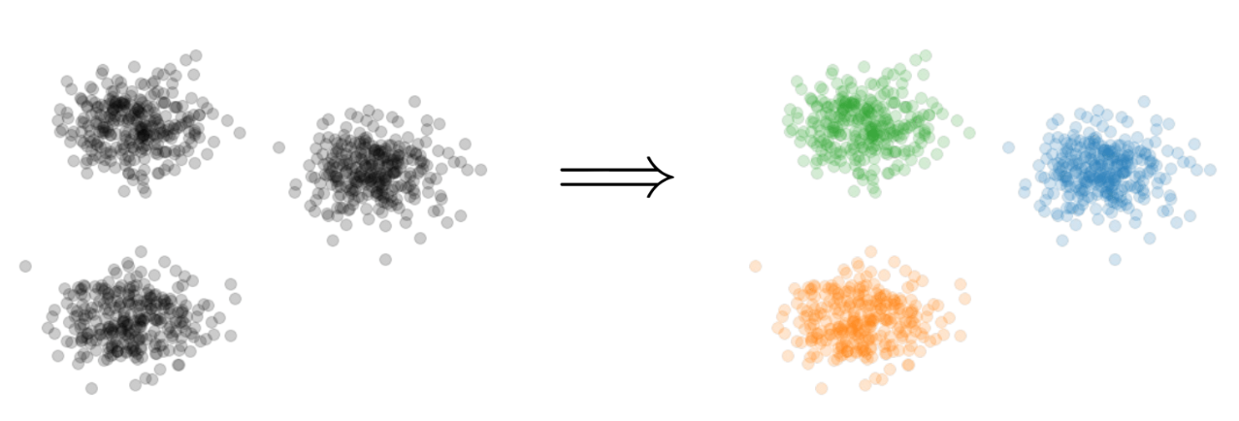
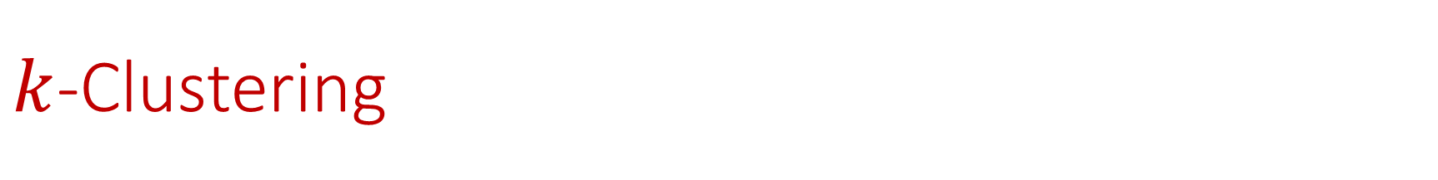

$k$-Clustering
Goal: Given input dataset $X$, partition $X$ so that “similar” points are in the same cluster and “different” points are in different clusters
There can be at most $k$ different clusters
$$k=3$$

Slide 4
$k$-Clustering
Question: How do we measure the “quality” of each clustering?
$$k=3$$

Slide 5
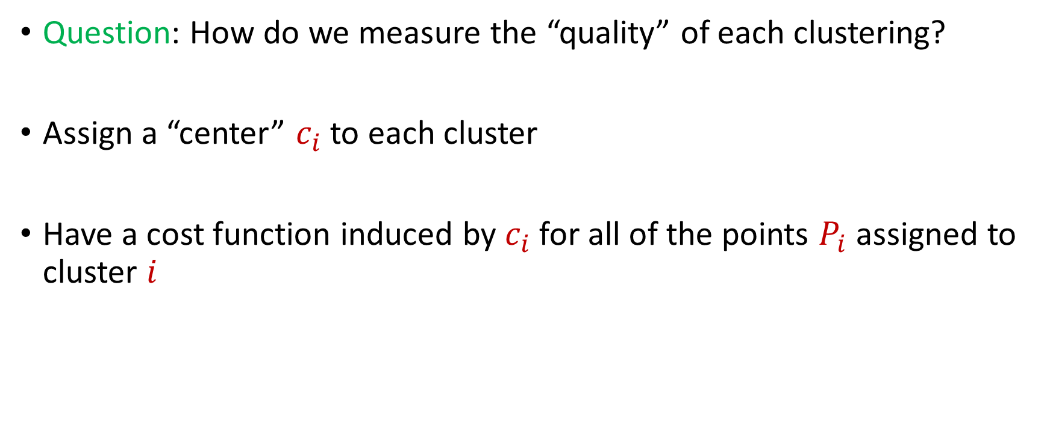
$k$-Clustering
Question: How do we measure the “quality” of each clustering?
Assign a “center” $c_{i}$ to each cluster
Have a cost function induced by $c_{i}$ for all of the points $P_{i}$ assigned to cluster $i$

Slide 6
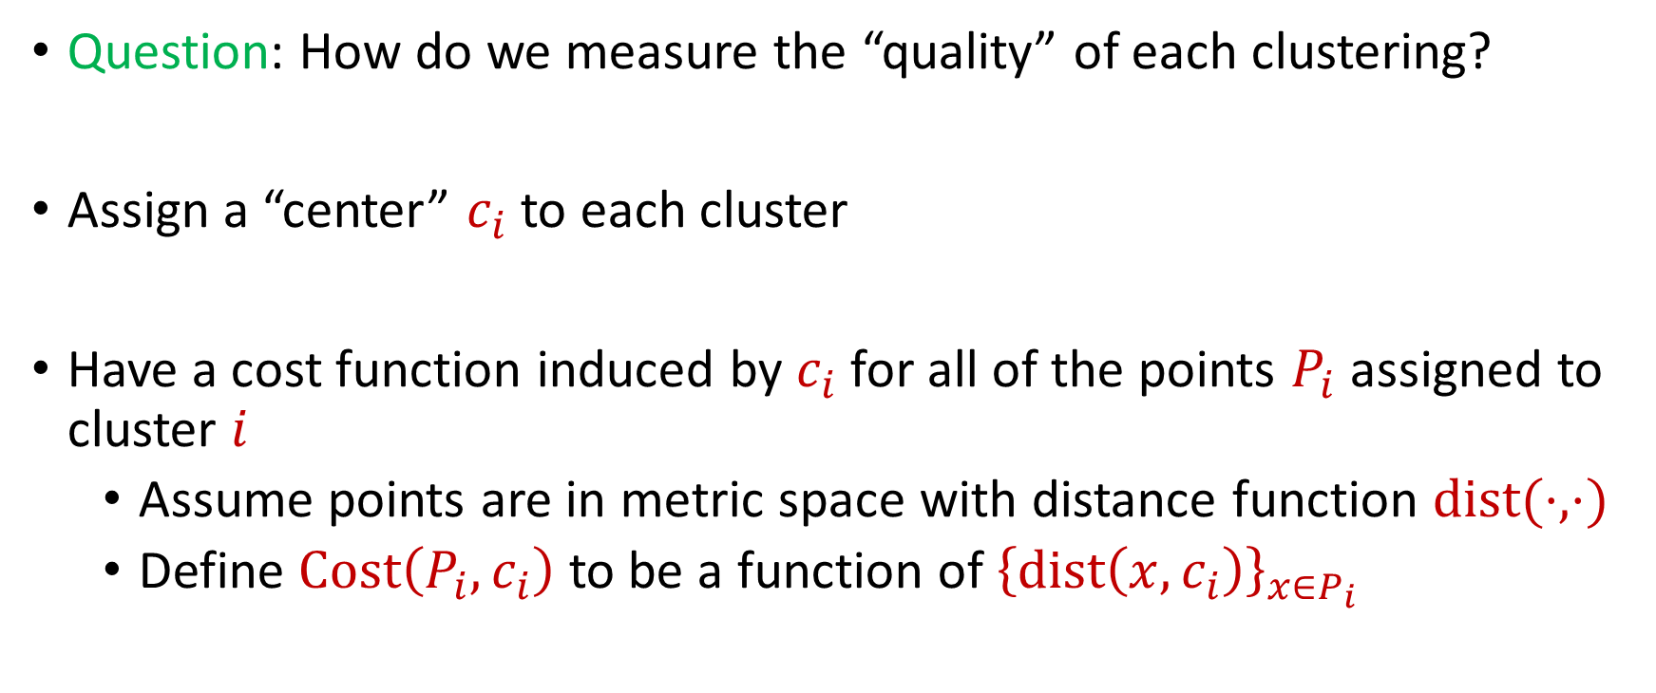
$k$-Clustering
Question: How do we measure the “quality” of each clustering?
Assign a “center” $c_{i}$ to each cluster
Have a cost function induced by $c_{i}$ for all of the points $P_{i}$ assigned to cluster $i$
Assume points are in metric space with distance function $dist(⋅,⋅)$
Define $Cost\left(P_{i},c_{i}\right)$ to be a function of ${\left\{dist\left(x,c_{i}\right)\right\}}_{x∈P_{i}}$

Slide 7
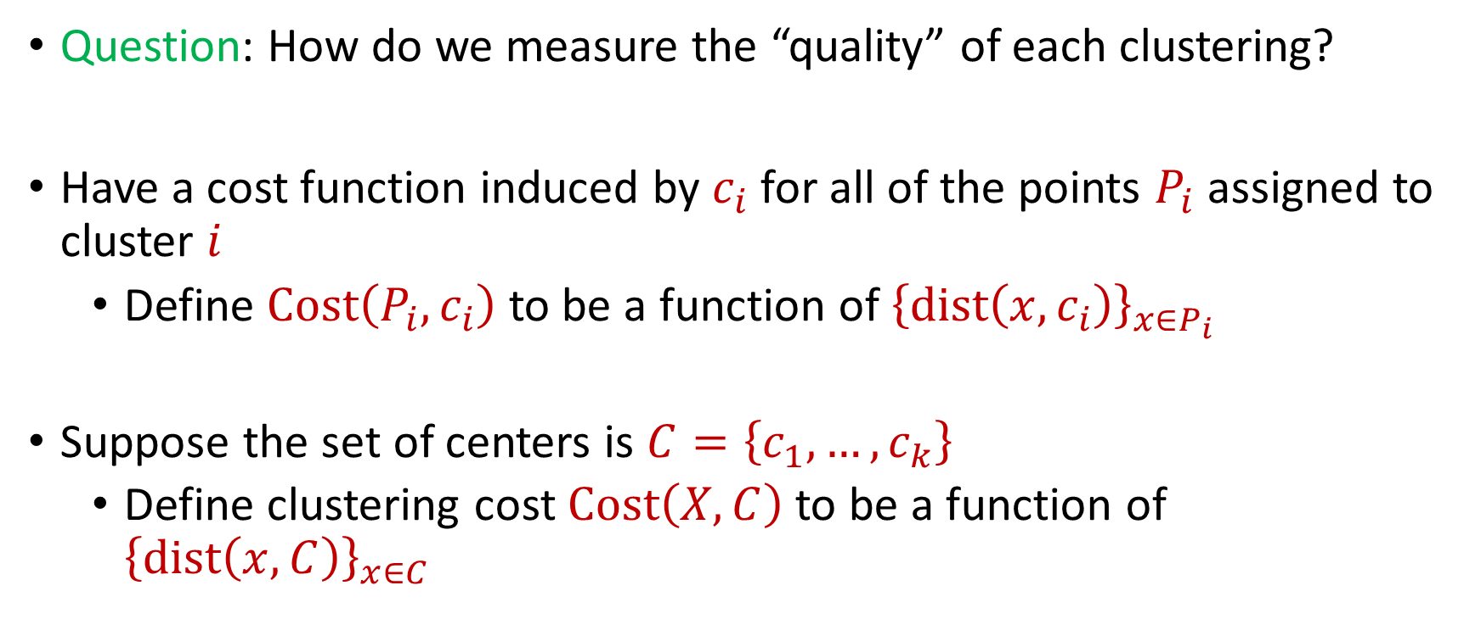
$k$-Clustering
Question: How do we measure the “quality” of each clustering?
Have a cost function induced by $c_{i}$ for all of the points $P_{i}$ assigned to cluster $i$
Define $Cost\left(P_{i},c_{i}\right)$ to be a function of ${\left\{dist\left(x,c_{i}\right)\right\}}_{x∈P_{i}}$
Suppose the set of centers is $C=\left\{c_{1},…, c_{k}\right\}$
Define clustering cost $Cost\left(X,C\right)$ to be a function of ${\left\{dist\left(x,C\right)\right\}}_{x∈C}$

Slide 8

$k$-Clustering
Define clustering cost $Cost\left(X,C\right)$ to be a function of ${\left\{dist\left(x,C\right)\right\}}_{x∈C}$

Slide 9
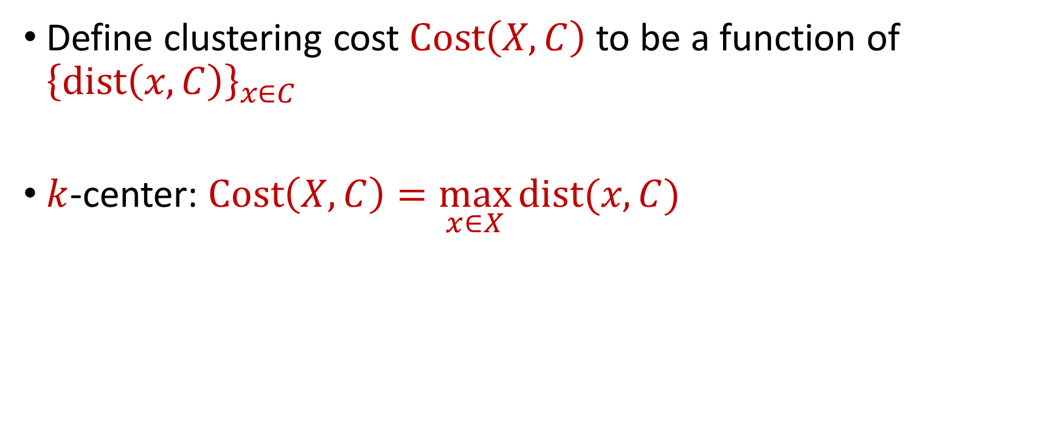
$k$-Clustering
Define clustering cost $Cost\left(X,C\right)$ to be a function of ${\left\{dist\left(x,C\right)\right\}}_{x∈C}$
$k$-center: $Cost\left(X,C\right)=\max_{x∈X}{dist(x,C)}$

Slide 10
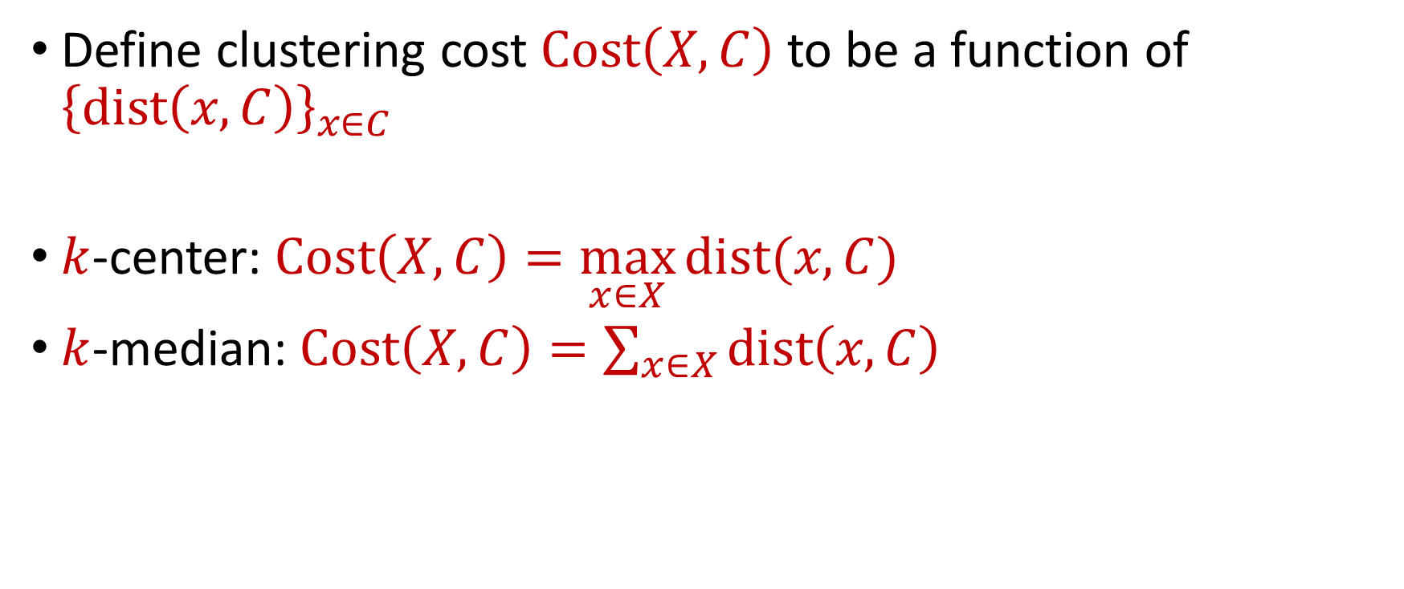
$k$-Clustering
Define clustering cost $Cost\left(X,C\right)$ to be a function of ${\left\{dist\left(x,C\right)\right\}}_{x∈C}$
$k$-center: $Cost\left(X,C\right)=\max_{x∈X}{dist(x,C)}$
$k$-median: $Cost\left(X,C\right)=\sum_{x∈X}{dist\left(x,C\right)}$

Slide 11

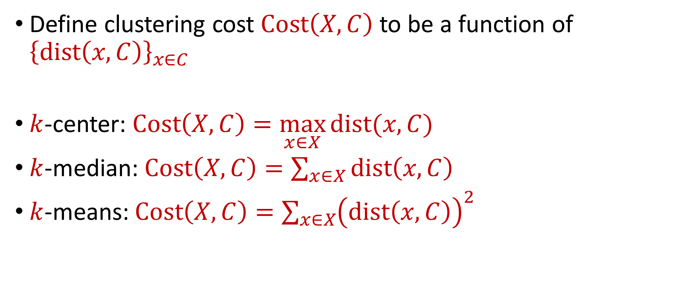






$k$-Clustering
Define clustering cost $Cost\left(X,C\right)$ to be a function of ${\left\{dist\left(x,C\right)\right\}}_{x∈C}$
$k$-center: $Cost\left(X,C\right)=\max_{x∈X}{dist(x,C)}$
$k$-median: $Cost\left(X,C\right)=\sum_{x∈X}{dist\left(x,C\right)}$
$k$-means: $Cost\left(X,C\right)=\sum_{x∈X}{{\left(dist\left(x,C\right)\right)}^{2}}$
$${\left(⋅\right)}^{2}$$
$${\left(⋅\right)}^{2}$$
$${\left(⋅\right)}^{2}$$
$${\left(⋅\right)}^{2}$$
$${\left(⋅\right)}^{2}$$
$${\left(⋅\right)}^{2}$$
$${\left(⋅\right)}^{2}$$

Slide 12

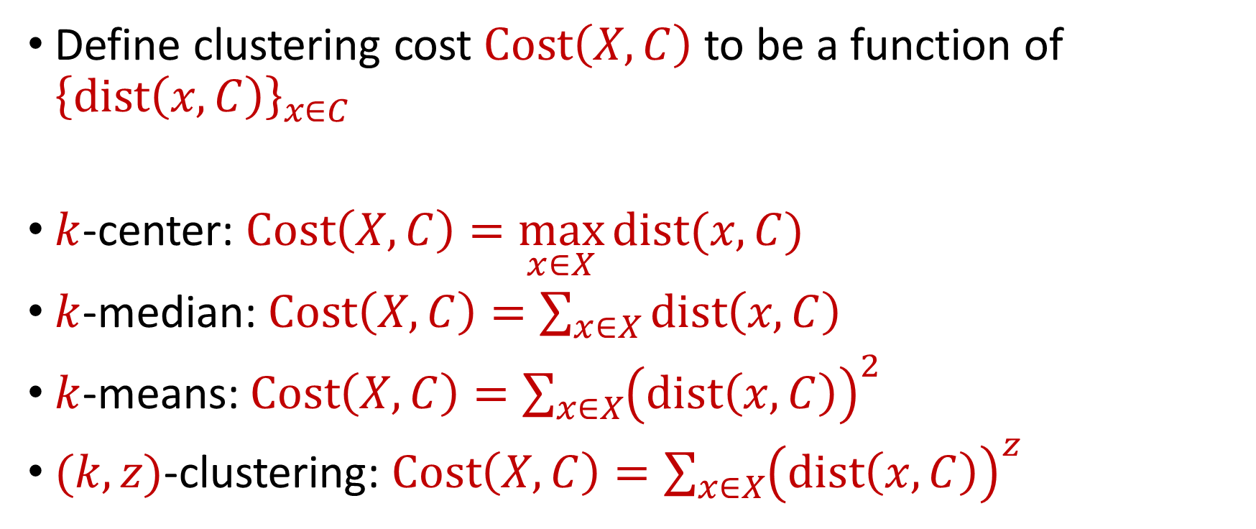






$k$-Clustering
Define clustering cost $Cost\left(X,C\right)$ to be a function of ${\left\{dist\left(x,C\right)\right\}}_{x∈C}$
$k$-center: $Cost\left(X,C\right)=\max_{x∈X}{dist(x,C)}$
$k$-median: $Cost\left(X,C\right)=\sum_{x∈X}{dist\left(x,C\right)}$
$k$-means: $Cost\left(X,C\right)=\sum_{x∈X}{{\left(dist\left(x,C\right)\right)}^{2}}$
$(k,z)$-clustering: $Cost\left(X,C\right)=\sum_{x∈X}{{\left(dist\left(x,C\right)\right)}^{z}}$
$${\left(⋅\right)}^{z}$$
$${\left(⋅\right)}^{z}$$
$${\left(⋅\right)}^{z}$$
$${\left(⋅\right)}^{z}$$
$${\left(⋅\right)}^{z}$$
$${\left(⋅\right)}^{z}$$
$${\left(⋅\right)}^{z}$$

Slide 13
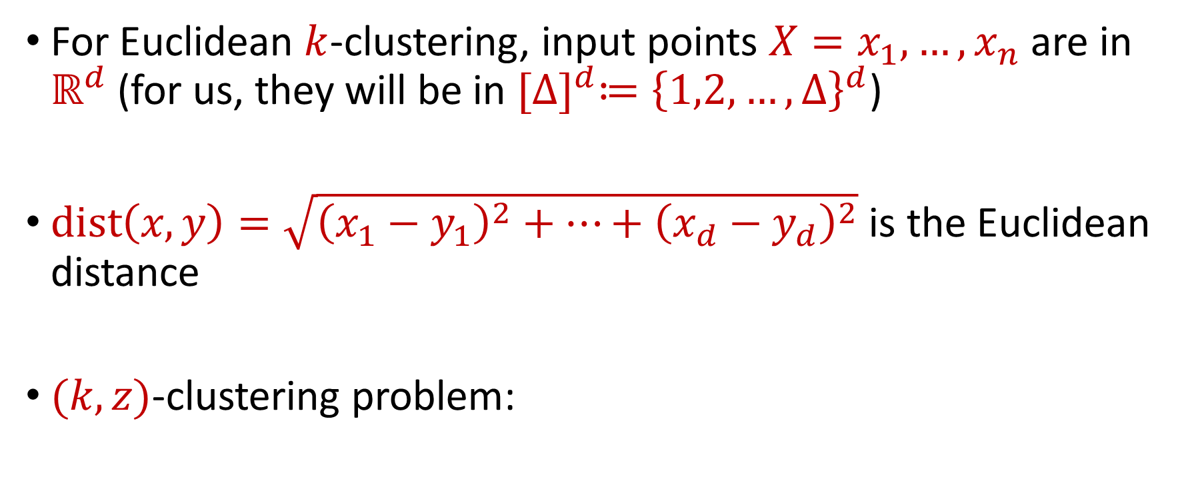

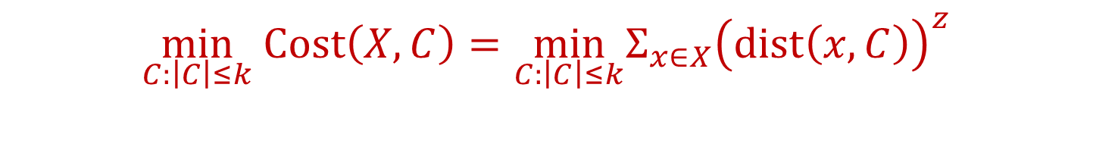
Euclidean $k$-Clustering
For Euclidean $k$-clustering, input points $X=x_{1},…,x_{n}$ are in $ℝ^{d}$ (for us, they will be in ${[Δ]}^{d}≔{\left\{1,2,…,Δ\right\}}^{d}$)
$dist\left(x,y\right)=\sqrt{{\left(x_{1}−y_{1}\right)}^{2}+…+{\left(x_{d}−y_{d}\right)}^{2}}$ is the Euclidean distance
$(k,z)$-clustering problem:
$$\min_{C:\left|C\right|≤k} Cost\left(X,C\right)=\min_{C:\left|C\right|≤k}{Σ_{x∈X}\left(dist\left(x,C\right)\right)}^{z}$$

Slide 14

The Streaming Model
Input: Updates to an underlying data set $X$ that arrive sequentially
Output: Evaluation (or approximation) of a given function
Goal: Use space sublinear in the size $n$of the input $X$

Slide 15
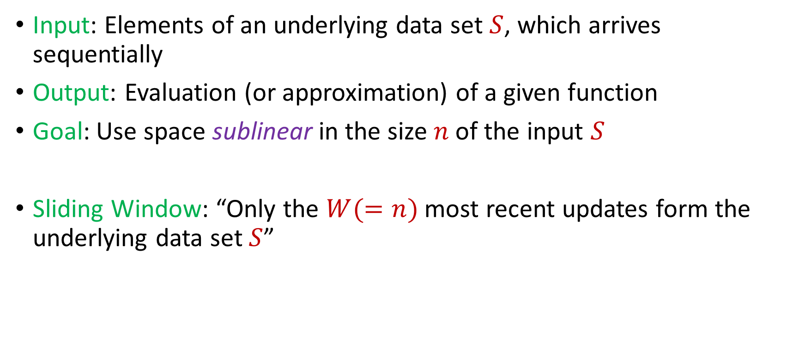
Streaming / Sliding Window Model
Input: Elements of an underlying data set $S$, which arrives sequentially
Output: Evaluation (or approximation) of a given function
Goal: Use space sublinear in the size $n$of the input $S$
Sliding Window: “Only the $W(=n)$ most recent updates form the underlying data set $S$”
1 0 1 1 1 0 0 1
Notes:
Let’s start by breaking down each of the terms in the title. To understand the sliding window model, we first have to understand the streaming model of computation, in which elements of an underlying data set S, arrive sequentially and the goal is to evaluate or approximate some given function on this dataset, using space sublinear in S. In the sliding window model, only the W most recent updates form the underlying data set

Slide 16
Streaming / Sliding Window Model
Input: Elements of an underlying data set $S$, which arrives sequentially
Output: Evaluation (or approximation) of a given function
Goal: Use space sublinear in the size $n$of the input $S$
Sliding Window: “Only the $W(=n)$ most recent updates form the underlying data set $S$”
1 0 1 1 1 0 0 1 1

Slide 17
Streaming / Sliding Window Model
Input: Elements of an underlying data set $S$, which arrives sequentially
Output: Evaluation (or approximation) of a given function
Goal: Use space sublinear in the size $n$of the input $S$
Sliding Window: “Only the $W(=n)$ most recent updates form the underlying data set $S$”
1 0 1 1 1 0 0 1 1 0

Slide 18
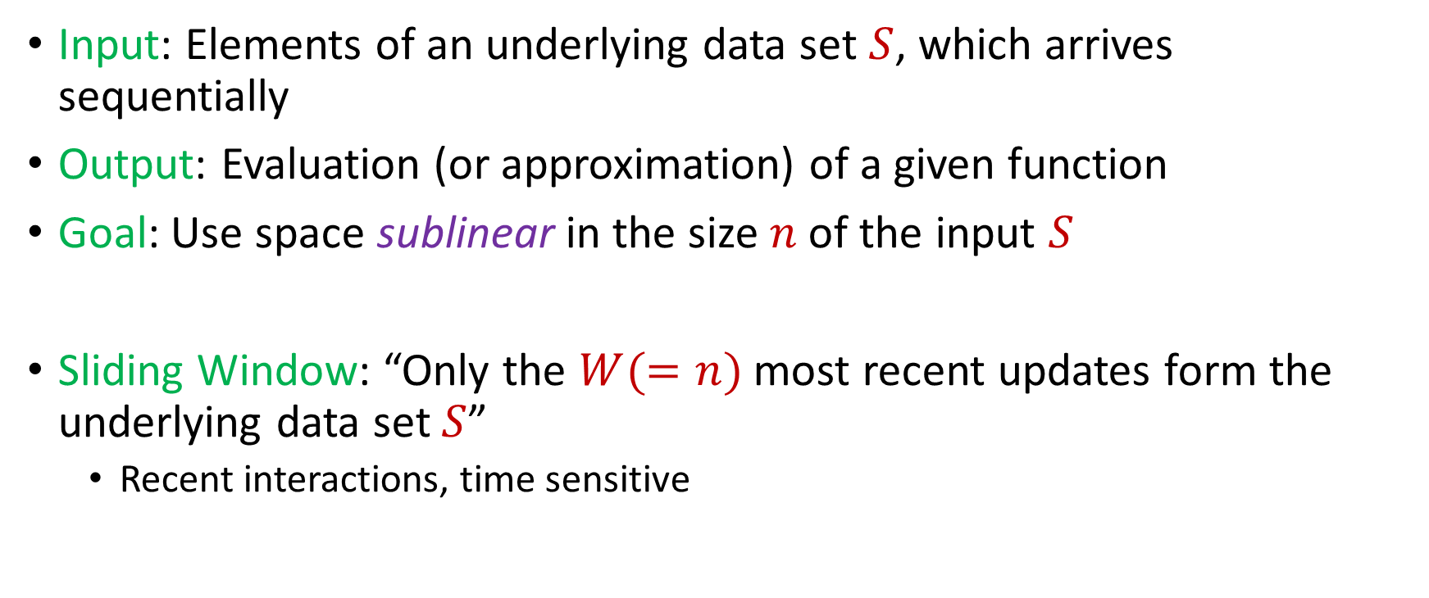
Streaming / Sliding Window Model
Input: Elements of an underlying data set $S$, which arrives sequentially
Output: Evaluation (or approximation) of a given function
Goal: Use space sublinear in the size $n$of the input $S$
Sliding Window: “Only the $W(=n)$ most recent updates form the underlying data set $S$”
Recent interactions, time sensitive
1 0 1 1 1 0 0 1 1 0 1
Notes:
The sliding window model emphasizes recent data and thus is appropriate for settings that are time sensitive.

Slide 19
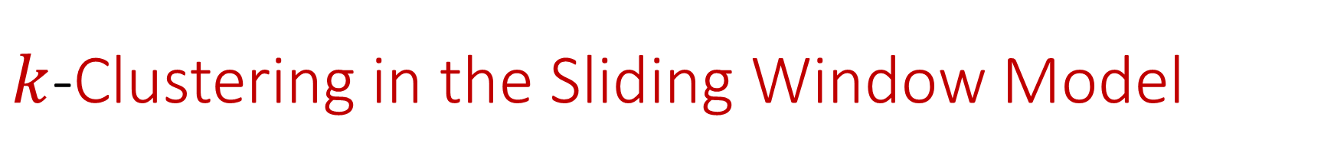
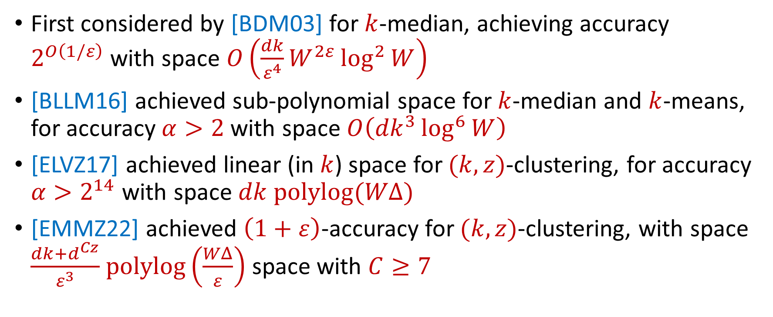
$k$-Clustering in the Sliding Window Model
First considered by [BDM03] for $k$-median, achieving accuracy $2^{O\left(1/ε\right)}$with space $O\left(\frac{dk}{ε^{4}}W^{2ε}\log^{2}{W}\right)$
[BLLM16] achieved sub-polynomial space for $k$-median and $k$-means, for accuracy $α>2$ with space $O\left({dk}^{3}\log^{6}{W}\right)$
[ELVZ17] achieved linear (in $k$) space for $(k,z)$-clustering, for accuracy $α>2^{14}$ with space $dk polylog(WΔ)$
[EMMZ22] achieved $\left(1+ε\right)$-accuracy for $(k,z)$-clustering, with space $\frac{dk+d^{Cz}}{ε^{3}}$ $polylog\left(\frac{WΔ}{ε}\right)$ space with $C≥7$
Notes:
The sliding window model emphasizes recent data and thus is appropriate for settings that are time sensitive.

Slide 20
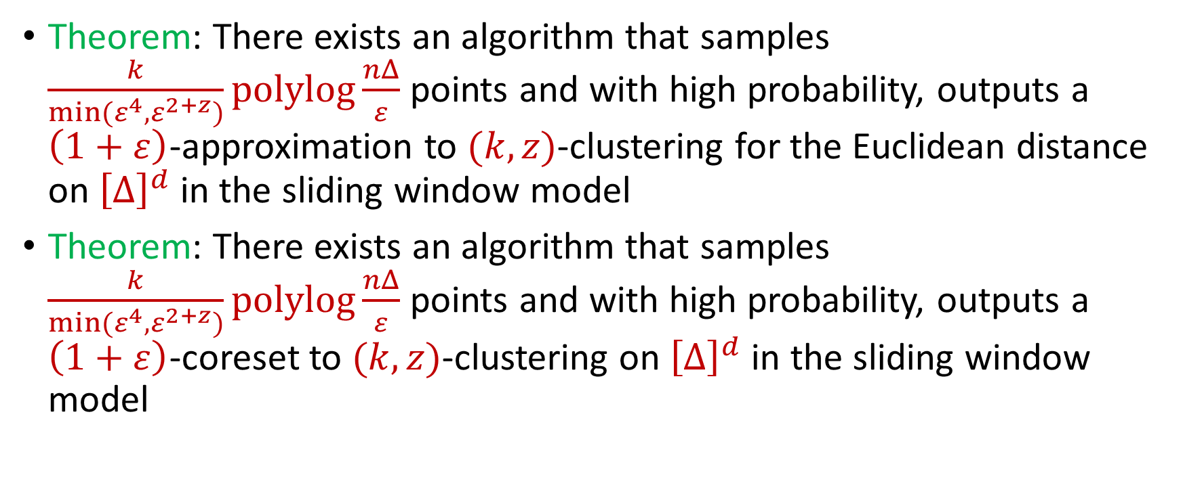
Our Results
Theorem: There exists an algorithm that samples $\frac{k}{min(ε^{4},ε^{2+z})}polylog\frac{nΔ}{ε}$ points and with high probability, outputs a $\left(1+ε\right)$-approximation to $(k,z)$-clustering for the Euclidean distance on ${\left[Δ\right]}^{d}$ in the sliding window model
Theorem: There exists an algorithm that samples $\frac{k}{min(ε^{4},ε^{2+z})}polylog\frac{nΔ}{ε}$ points and with high probability, outputs a $\left(1+ε\right)$-coreset to $(k,z)$-clustering on ${\left[Δ\right]}^{d}$ in the sliding window model
Notes:
The sliding window model emphasizes recent data and thus is appropriate for settings that are time sensitive.

Slide 21
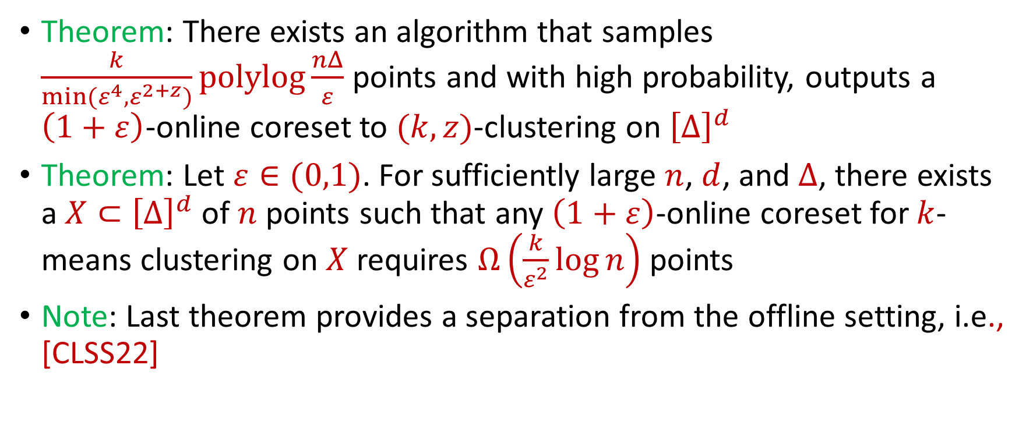
Our Results
Theorem: There exists an algorithm that samples $\frac{k}{min(ε^{4},ε^{2+z})}polylog\frac{nΔ}{ε}$ points and with high probability, outputs a $\left(1+ε\right)$-online coreset to $(k,z)$-clustering on ${\left[Δ\right]}^{d}$
Theorem: Let $ε∈(0,1)$. For sufficiently large $n$, $d$, and $Δ$, there exists a $X⊂{\left[Δ\right]}^{d}$ of $n$ points such that any $\left(1+ε\right)$-online coreset for $k$-means clustering on $X$ requires $Ω\left(\frac{k}{ε^{2}}\log{n}\right)$ points
Note: Last theorem provides a separation from the offline setting, i.e., [CLSS22]
Notes:
The sliding window model emphasizes recent data and thus is appropriate for settings that are time sensitive.

Slide 22
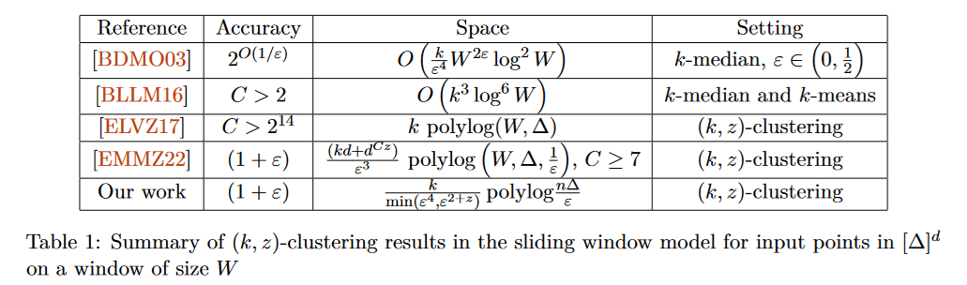
$k$-Clustering in the Sliding Window Model
Notes:
The sliding window model emphasizes recent data and thus is appropriate for settings that are time sensitive.

